Slide 1


Bridging the Gap:
Understanding Title IX as Academic Advisors
Bob Alston, Assistant Dean of Students NKU
Marg Z. Basehart, Academic Advisor UTK
Merrill Walker, Academic Advisor UTK

Slide 2
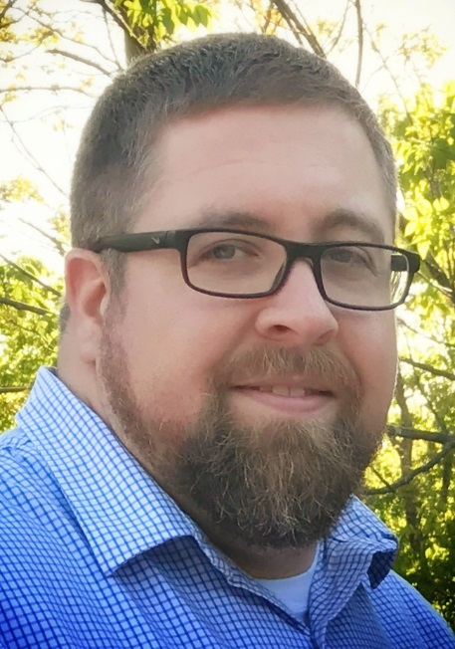

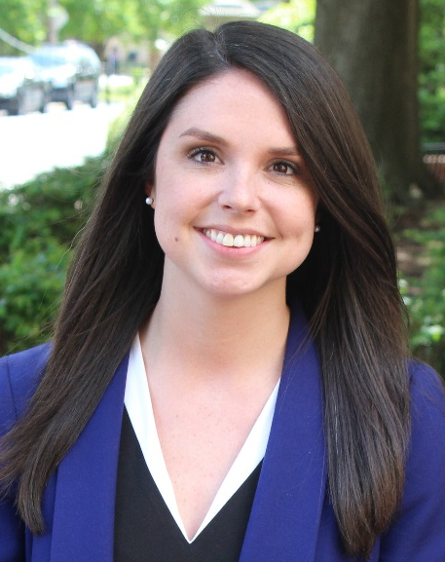
Bob Alston
Assistant Dean of Students
Northern Kentucky University
Marg Basehart
Senior Academic Advisor
University of Tennessee-Knoxville
Merrill Walker
Academic Advisor
University of Tennessee-Knoxville
Notes:
Merrill will welcome everyone and see who we have in the room, begin introductions and background
Marg will talk about purpose of presentation
Bob will discuss his area of expertise

Slide 3
History & Background of Title IX
Title IX of the Education Amendments of 1972
Prohibits discrimination “on the basis of sex” in any program or activity receiving federal financial assistance
Applies to public and private recipients
  UTK and NKU are subject to Title IX.
Recipients have an obligation to make reasonable efforts to investigate sexual misconduct of which they know or should know.
Recipients must provide for prompt, adequate, reliable, and impartial disposition of complaints of sex discrimination, including sexual harassment, assault, and retaliation.
Notes:
Bob

Slide 4
Title IX Specifics
Sexual harassment can qualify as discrimination under Title IX if it is:
  Severe
  Pervasive
  Objectively offensive
Combined or standing alone, the harassment must effectively bar the victim's access to an educational opportunity or benefit.
Courts have generally found that even a single instance of non-consensual sex or sexual assault by another student meets this standard.
To be held responsible, the college or university must have authority over the harasser and over the environment in which the harassment takes place.
  Includes reasonably known/should have known
Notes:
Bob

Slide 5
Office of Civil Rights Guidance
1998 -- Title IX and Sex Discrimination
2008 -- Sexual harassment in educational institutions
April 4, 2011 -- Dear Colleague Letter- policy guidance on Title IX requirements related to sexual violence
June 25, 2013 -- Dear Colleague Letter regarding pregnant and parenting students
2014 -- Q&A about Title IX and Sexual Violence
April 24, 2015 -- Dear Colleague Letter regarding Title IX Coordinators
September 22, 2017 -- Dear Colleague Letter and Q&A on Campus Sexual Misconduct
Notes:
Bob

Slide 6

Campus Sexual Assault
Notes:
Marg

Slide 7
Campus Sexual Assault
Why is there so much discussion of campus sexual assault?
It isn’t clear that incidents are on the rise, but in recent years activists built a strong movement to seek justice for victims/survivors.
The Obama administration put colleges on notice with its Dear Colleague Letter, and students employed Title IX as a vehicle for change.
  Federal complaints filed against colleges to allege missteps
  Though the 2011 guidance has now been withdrawn, colleges are still responsible for protecting their students.
The Education Department’s Office for Civil Rights began investigating more colleges.
  Backlash arose from due-process advocates and accused men who felt a rush to judgment.
Title IX Sexual Assault Investigation Tracker from The Chronicle of Higher Education | About. (n.d.). Retrieved from https://projects.chronicle.com/titleix/about/
Notes:
Marg

Slide 8
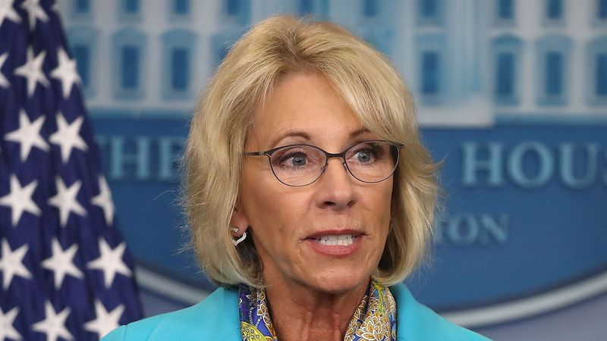
New Interim Guidance
On September 22nd, the U.S. Department of Education rescinded pieces of Obama-era guidance and implemented interim guidance.
Withdrew two key documents:
  2011 “Dear Colleague” letter, which kicked off a new era of enforcement
  2014 questions-and-answers document, which offered colleges additional guidance on how they should respond to reported sexual violence
What does this mean?
  Gives colleges the discretion to use a “clear and convincing” standard of evidence, which is higher than the “preponderance of the evidence” standard.
Notes:
Merrill

Slide 9
New Interim Guidance (cont.)
What is the impact of these changes?
Advocates for sexual-assault victims worry that making it harder for people to prove their cases could discourage them from reporting.
Those who feel too many students are being expelled based on “flimsy evidence” welcome the more-rigorous standard of proof.
Colleges may now facilitate informal resolutions, including mediation, if all parties agree to participate in that process.
Colleges don’t have to allow appeals; if they do, they can decide whether to permit both parties to appeal or only the accused.
There is “no fixed time frame under which a school must complete a Title IX investigation.”
Notes:
Merrill- will also mention recent bill introduced by House Democrats
Will always be a political issue

Slide 10
Financial, Legal, and Student Impact
Financial :
  College budget
    UTK spent $700,000 in the past two years supporting the Title IX office.
    Most colleges have become more dependent on tuition as federal and state funding decreases.
    Current administration is cutting funding for federal anti-discrimination programs.
  Enrollment
    Students may have to withdraw from classes to handle trauma/heal.
    Loss of tuition for the college
Lawsuits:
  In this era of enforcement, the government has conducted 441 investigations of colleges for possibly mishandling reports of sexual violence.
  So far, 84 cases have been resolved and 357 remain open.
  Lawsuits are often damaging to institution’s reputation.
    UTK settled Title IX lawsuit for $2.48 million in 2016.
Notes:
Marg

Slide 11
Student Experience and Impact
First-year programming on college campuses
  Presentations and online modules (i.e. Haven) used to educate students
  Incorporated into orientation, welcome week, and other first-year programs
It’s on Us Campaign- national movement to end sexual assault
  https://www.youtube.com/user/ItsOnUsCampaign/videos
Save our Sons: a site dedicated to the families whose college sons have been falsely accused of sexual misconduct
  “This is my story about my son- Silent No More”
Notes:
Marg- show videos and website
Several institutions have mandated completions
Break to watch It’s on Us

Slide 12
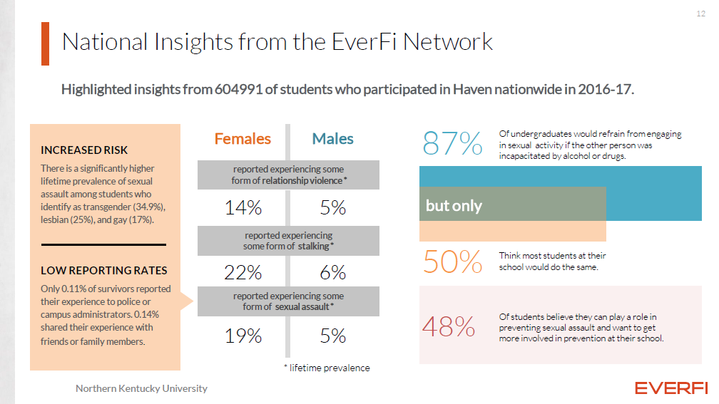
Notes:
Bob

Slide 13
Student Experience and Impact (cont.)
Women with prior teen sexual victimization experiences tended to enter college with lower GPA scores and tended to earn lower grades during their first freshman year than did non-victimized women students.
“The… pattern was true for women who were sexually assaulted… during their first semester; their grade point average (GPA) subsequently dropped” (“Sexual Assault Can Inhibit Student Success | Psychology,” n.d.).
The level of negative academic impact on a woman’s academic performance was positively related to the severity of her victimization:
  Higher rates of GPAs under 2.5 were seen among women for those whose assault experience was a rape as compared to other forms of sexual assault.
Notes:
Supporting evidence

Slide 14

Mandatory Reporting

Slide 15
Are You a Mandated Reporter?
Depends on the type of issue
  Responsible Employees (REs) must report Title IX related information
  Campus Security Authorities (CSAs) must report potential Clery Act crimes
  Other state laws and related issues (child/elder abuse, etc.)
Depends on institution and institution type
  Policies vary; refer to your institution’s Title IX office or Human Resources
  Most institutions have Title IX training for employees who are REs/CSAs
At UTK, the following employees are deemed CSAs:
  GTAs, lecturers, adjuncts, assistant/associate/full professors
  Exempt staff members, supervisors, or other employees with Mandatory Reporter responsibilities
Notes:
Tag team?

Slide 16
Reporting Incidents
Disclosure :
  Can be verbal or written
  Confidentiality vs Privacy
Advise student that you are a mandated reporter; define your role
Listen to the student
Assist student and provide information about services/options
Encourage student to report incident to law enforcement and/or student conduct
Report the incident to your institution
Refer student to appropriate medical personnel and campus resources that maintain confidentiality
Support student and make them feel as comfortable as possible
Follow up with the student
Your institution is “on notice” when:
  The situation is reasonably known or;
  Should have been known
Notes:
Merrill

Slide 17

What is our role?
Support
  Maintain relationship with student
  referrals, providing information
  check in with student
  Believe the student and advocate on their behalf
Listen and document everything
Appropriate reporting
Communicate with Title IX office at your institution
Self Care (for advisor)
  Often overlooked and undervalued
Seeking education and trainings
  Check with your institution
  Keep up with current events
Notes:
Merrill

Slide 18
References
Jordan, C. E., Combs, J. L., & Smith, G. T. (2014). An Exploration of Sexual Victimization and Academic Performance Among College Women. Trauma, Violence, & Abuse, 15(3), 191–200. https://doi.org/10.1177/1524838014520637
Mangan, K. (2017, September 22). What You Need to Know About the New Guidance on Title IX. The Chronicle of Higher Education. Retrieved September 30, 2017, from http://www.chronicle.com/article/What-You-Need-to-Know-About/241277
Sexual Assault Can Inhibit Student Success | Psychology. (n.d.). Retrieved September 29, 2017, from https://psychology.as.uky.edu/sexual-assault-can-inhibit-student-success
Title IX Sexual Assault Investigation Tracker from The Chronicle of Higher Education | About. (n.d.). Retrieved from https://projects.chronicle.com/titleix/about/
Zamudio-Suaréz, F. (2017, September 22). Education Dept. Replaces Obama-Era Title IX Directives With New Interim Guidance. The Chronicle of Higher Education. Retrieved September 30, 2017, from http://www.chronicle.com/blogs/ticker/education-dept-replaces-obama-era-title-ix-directives-with-new-interim-guidance/120249

Slide 19
Questions?

